Slide 1
Maths
Unit 2 – Numbers and Sequences
03.09.2026
WALT: Use knowledge of multiplication and square numbers to recognise cube numbers.

Slide 2
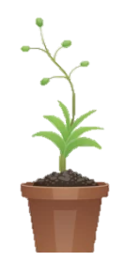
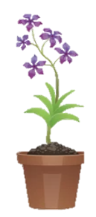

WALT: Use knowledge of multiplication and square numbers to recognise cube numbers.
With support, I can complete a table about cube numbers.
Independently, I can complete a table about cube numbers.
I can solve and write my own riddles about cube numbers.

Slide 3
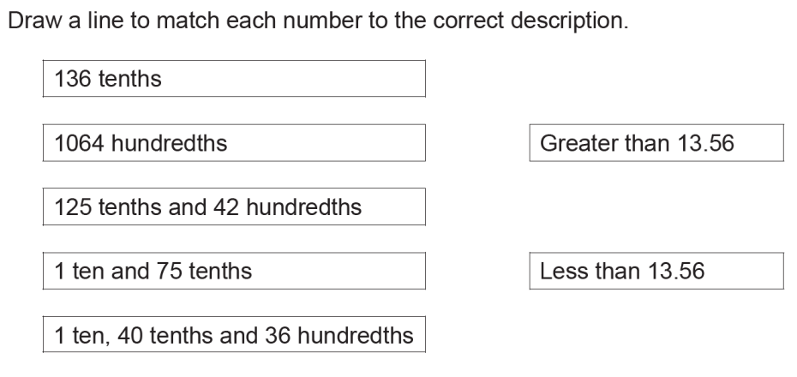
Retrieval Practice
WALT: Use knowledge of multiplication and square numbers to recognise cube numbers.

Slide 4
Starter – Last lesson we learned that 4² is 4 x 4
WALT: Use knowledge of multiplication and square numbers to recognise cube numbers.
What do you think 4³ means?
4 x 4 x 4

Slide 5
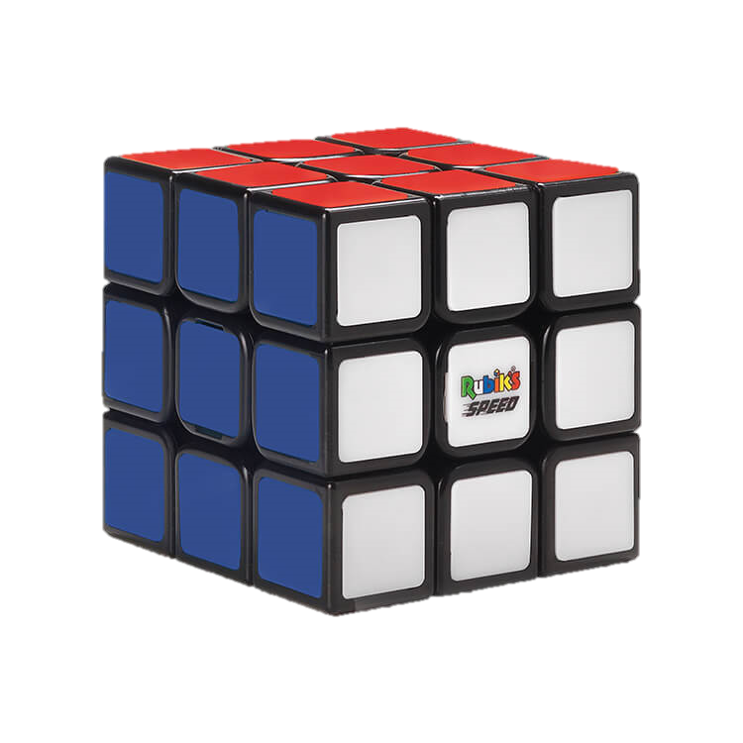
WALT: Use knowledge of multiplication and square numbers to recognise cube numbers.
When we multiply a number by itself 3 times we say it is cubed.
Imagine a cube that is 3 units in all 3 dimensions.
3
3³ = 3 x 3 x 3
3
3

Slide 6
Check your understanding
WALT: Use knowledge of multiplication and square numbers to recognise cube numbers.
How many different ways can you write 4³?
4 x 4 x 4
64
4² x 4
16 x 4
4 x 16

Slide 7
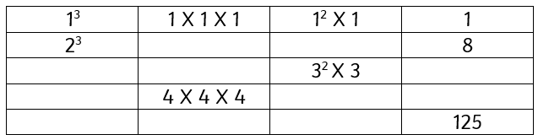
WALT: Use knowledge of multiplication and square numbers to recognise cube numbers.
Complete the table with support.
Complete the table independently.
Solve this riddle.
I am a cube number.
I am odd.
I am less than 50.
I have 2 digits.
What number am I?
Write your own riddle.

Slide 8
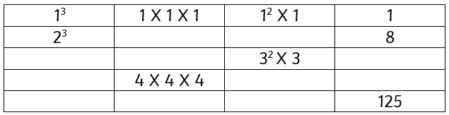
WALT: Use knowledge of multiplication and square numbers to recognise cube numbers.
2 X 2 X 2
2² X 2
3³
3 X 3 X 3
27
4³
4² X 4
64
5³
5 X 5 X 5
5² X 5

Slide 9
Plenary
WALT: Use knowledge of multiplication and square numbers to recognise cube numbers.
3 x 3
x
3 x 3 x 3
= 243
What is 3² X 3³ =
How could we write it using powers?
3⁵

